Slide 1
A Detailed Look in to Belarus Car Market
By : Team Pattern 6

Slide 2
Agenda
Introducing the Topic
Exploratory Data Analysis
Showcasing the Graphs
Model Building
Evaluation
Questions

Slide 3
Research Proposal
What factors determine the prices of cars in the second hand car market?
Color?
Engine Capacity?
Odometer Value?
Engine Type?
Year Produce?

Slide 4
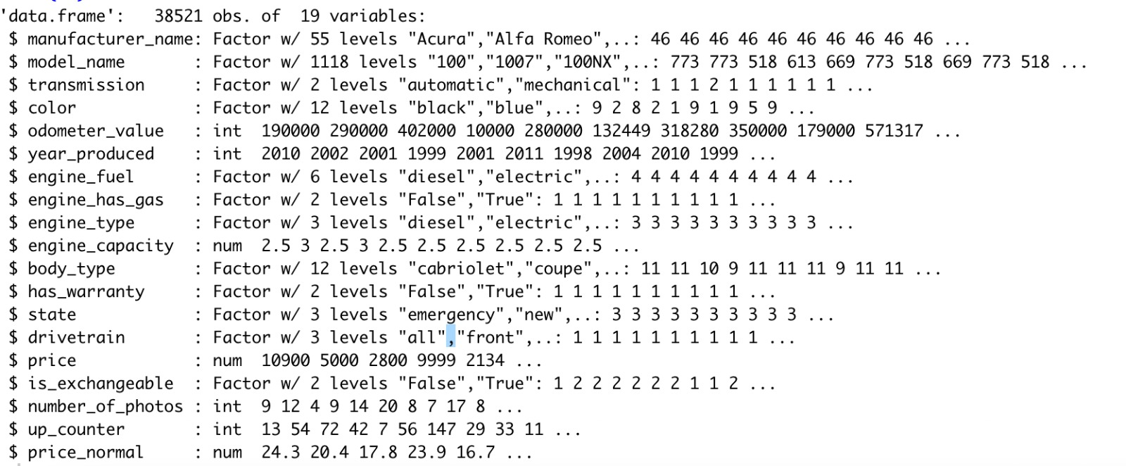
Data Set Information
Used car catalog for Belarus for the year 2019
Source: Kaggle
No. Observations: 38521
No. of variables: 19
MeanPrice: 6639.97$
Std.DevPrice=6428.15$

Slide 5
Step by Step Code – Will Delete
Importing Data
Renaming Features
Checking for Null Values
Summary of Data-Set
Descriptive Statistics
Ggplot – Has_Warranty vs Price
T-test Statistical Significance Test
Ggplot – Engine_type vs Price
T-Test for Diesel vs Gasoline
Test of Independence and Homogenity

Slide 6
Exploratory Data Analysis

Slide 7
EDA preparation
Dropping Null Values : engine_capacity(10)
Converting Variables to Numerical (ask the group)
Name Change: Price USD – Price

Slide 8
Exploring the Graphs

Slide 9
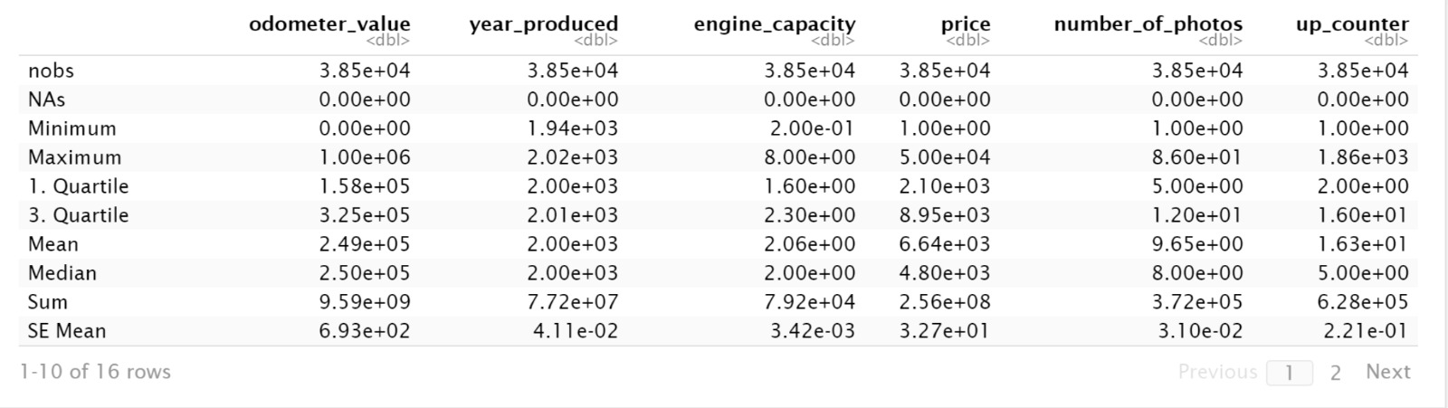
Descriptive – Basic Statistics for the Variables

Slide 10
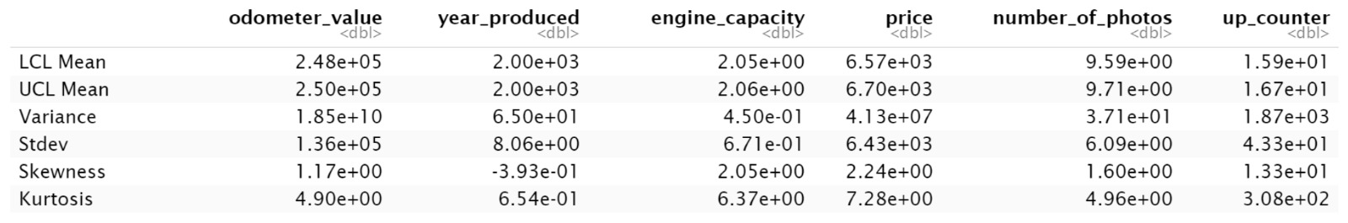
Descriptive – Basic Statistics for the Variables

Slide 11
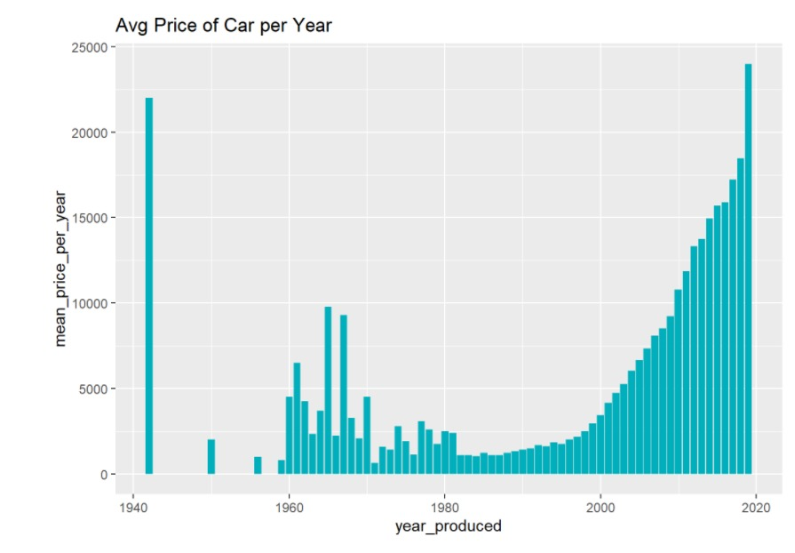
Average Price per Car vs Year Made

Slide 12
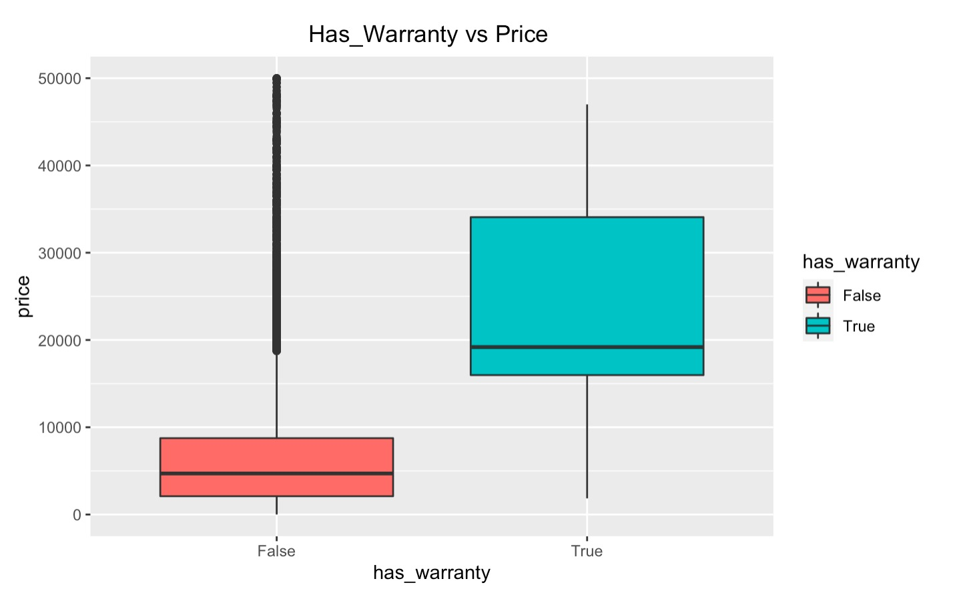
Has_Warranty vs Price – GphType:

Slide 13
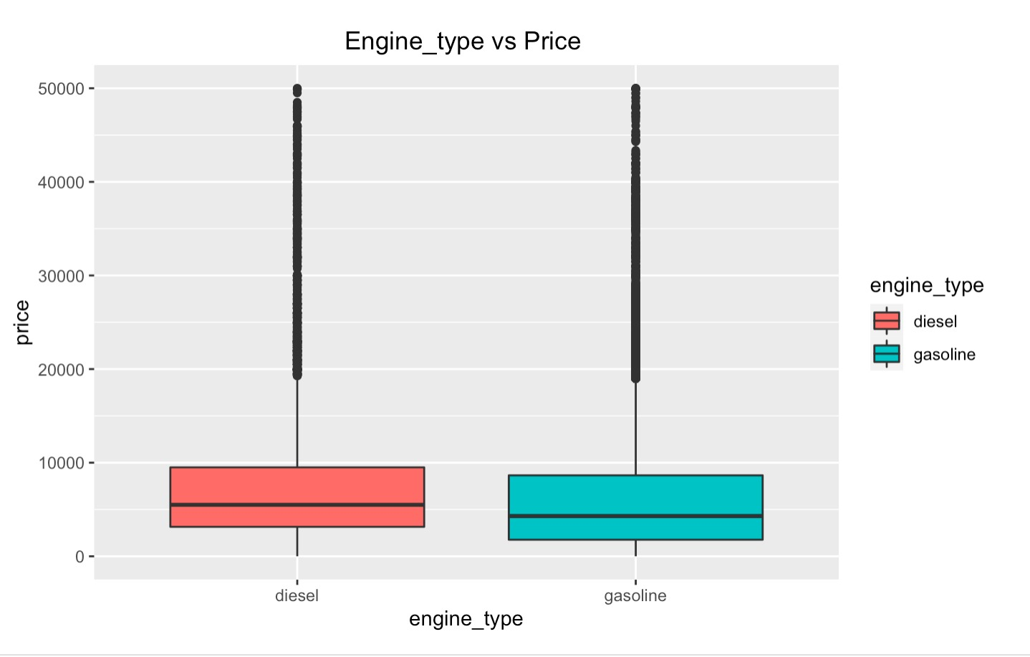
Engine_Type vs Price - GphType:

Slide 14
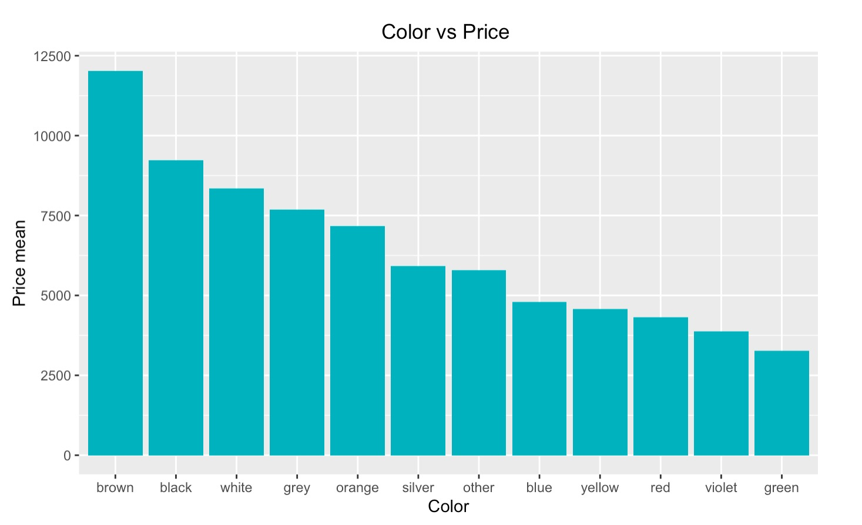
Color vs Price - GphType:

Slide 15
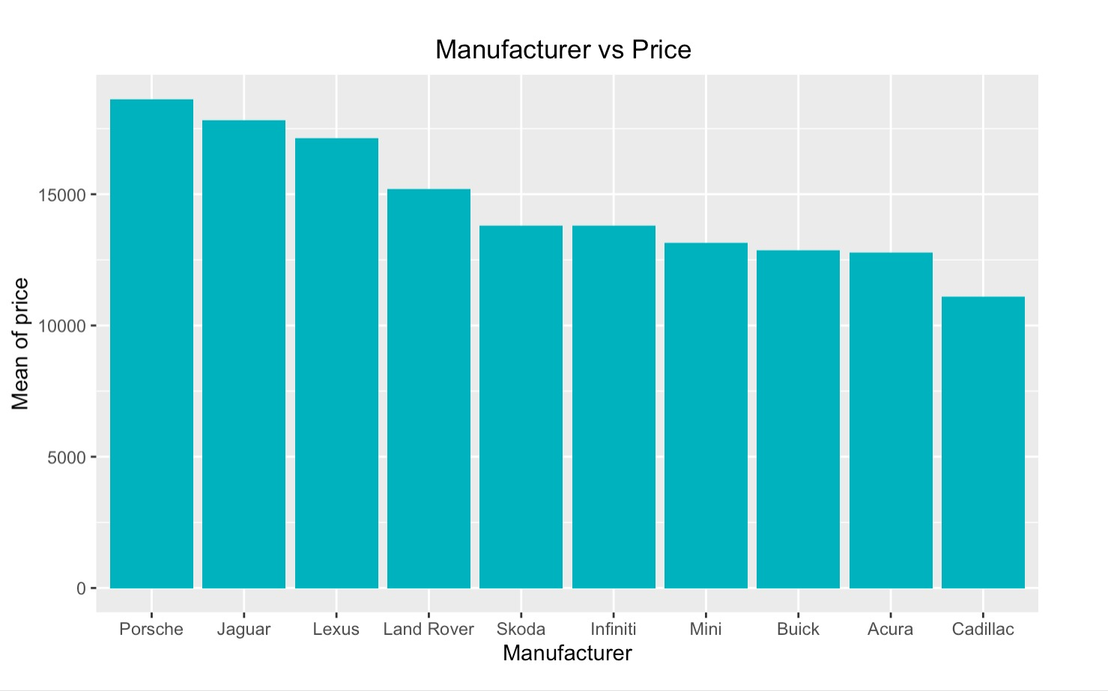
Manufacturer vs Price - GphType:

Slide 16
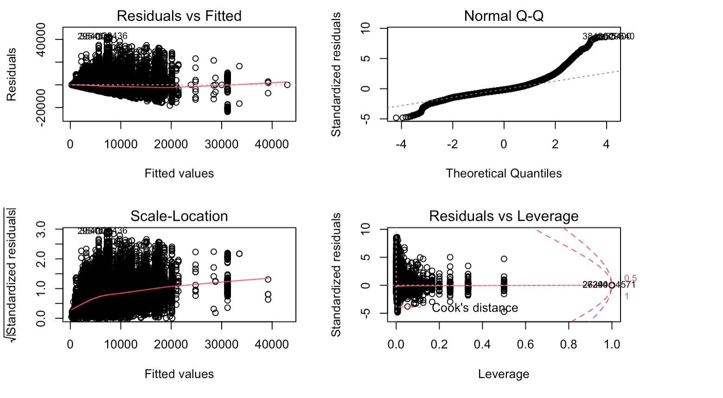
Price vs Color - GphType: ANOVA – One way

Slide 17
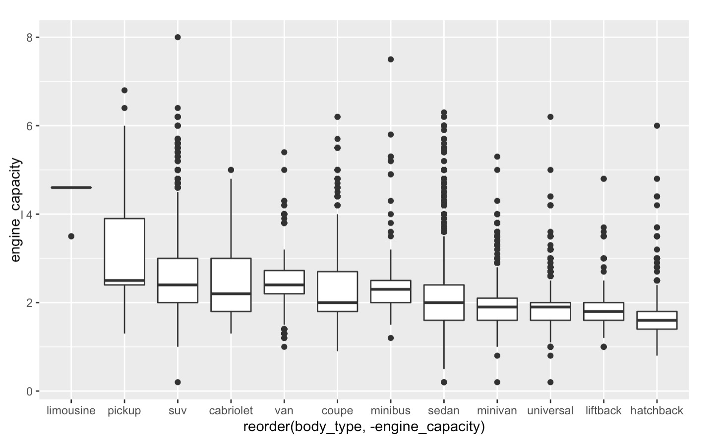
Engine Capacity vs Body Type - GphType: GGplot

Slide 18
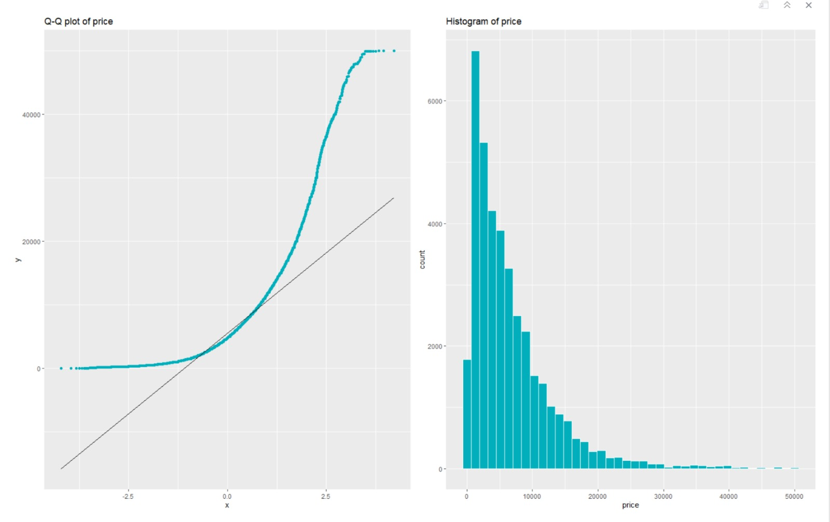
Q-Q Normalization

Slide 19
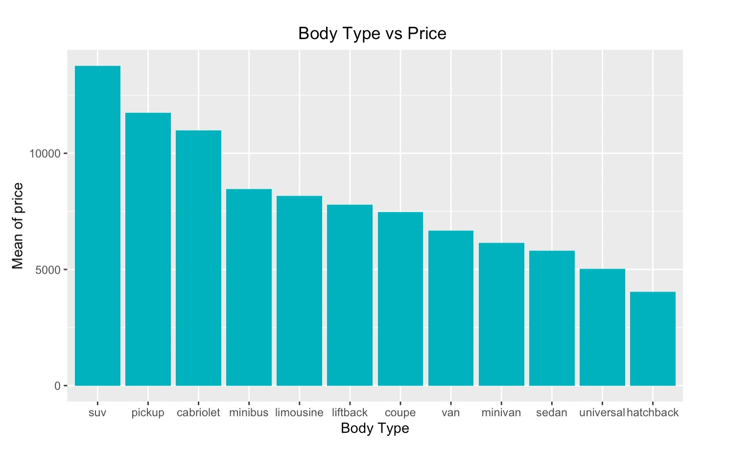
Body Type vs Price

Slide 20
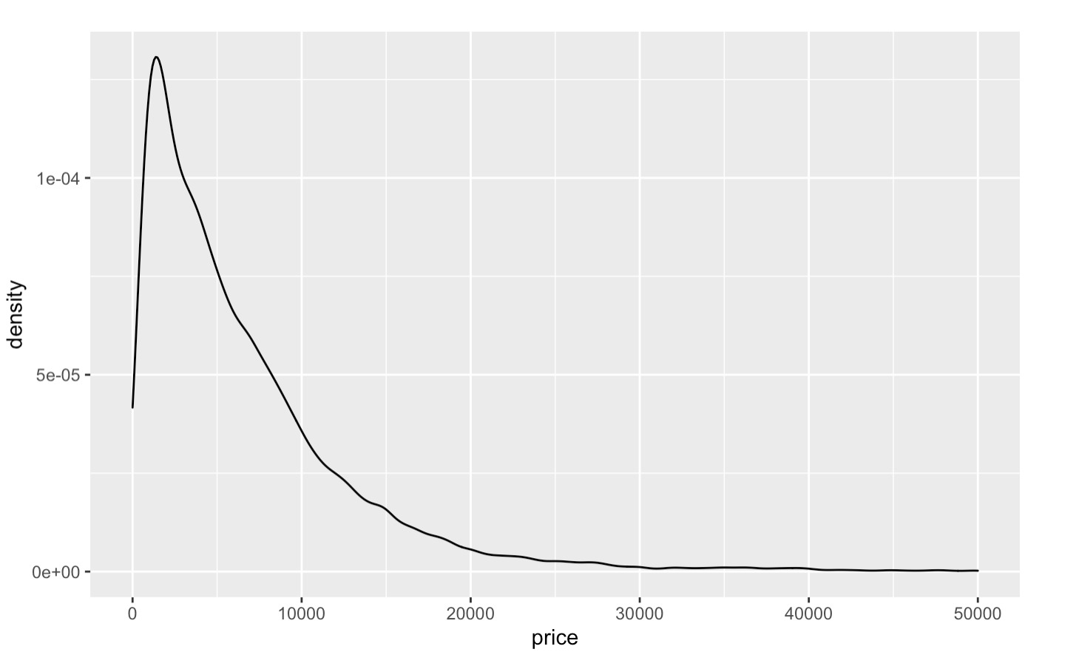
Price Plot - GphType: Density

Slide 21
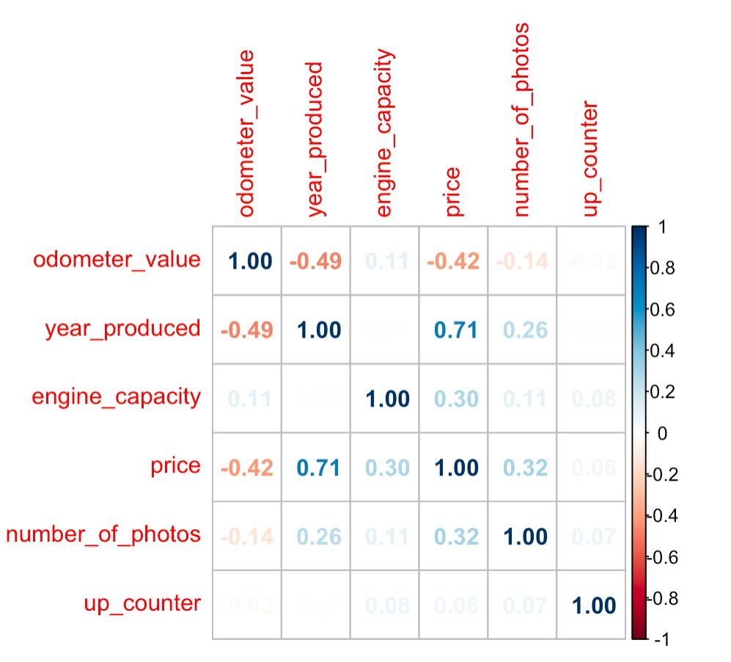
Correlation Plot

Slide 22
T - Test

Slide 23
ANOVA

Slide 24
Model Building

Slide 25
Model Building

Slide 26
Model Building

Slide 27
Model Building

